Slide 1
Congenital conditions of the ear
Dr.D.Anand Karthikeyan MS,
Associate Professor,
Dept of ENT.

Slide 2
overview
Embryology of the ear
Congenital conditions of external ear
Congenital conditions of middle ear
Congenital conditions of inner ear
Genetic basis
Chromosomal disorders
syndromes

Slide 3
Embryology of the ear

Slide 4
pinna

Slide 5
EAC

Slide 8
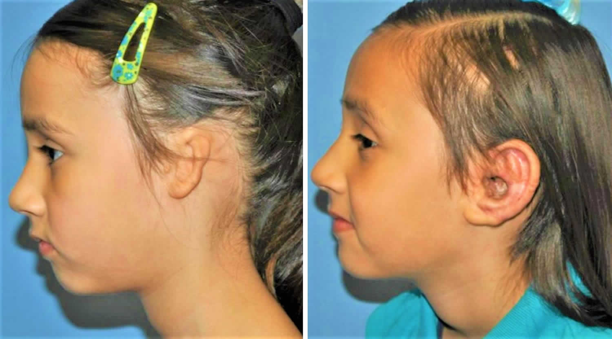
ANOTIA MICROTIA

Slide 9
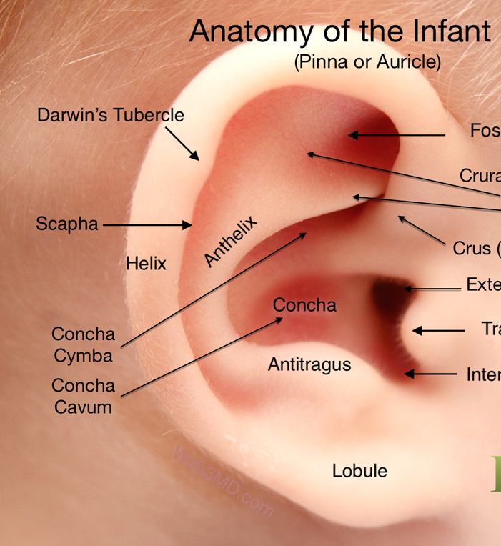
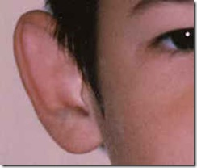
BAT EAR

Slide 10
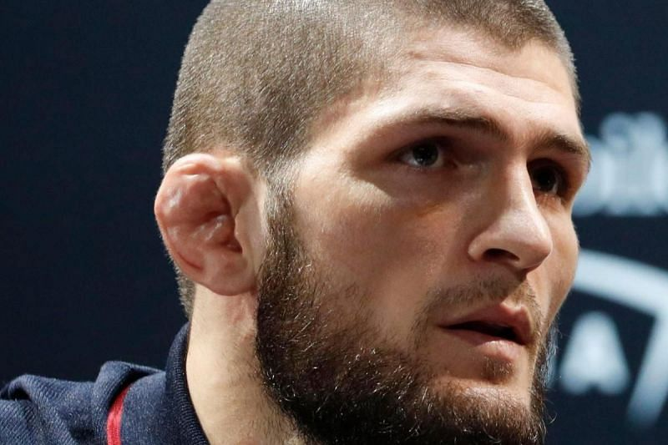
CAULIFLOWER EAR

Slide 11
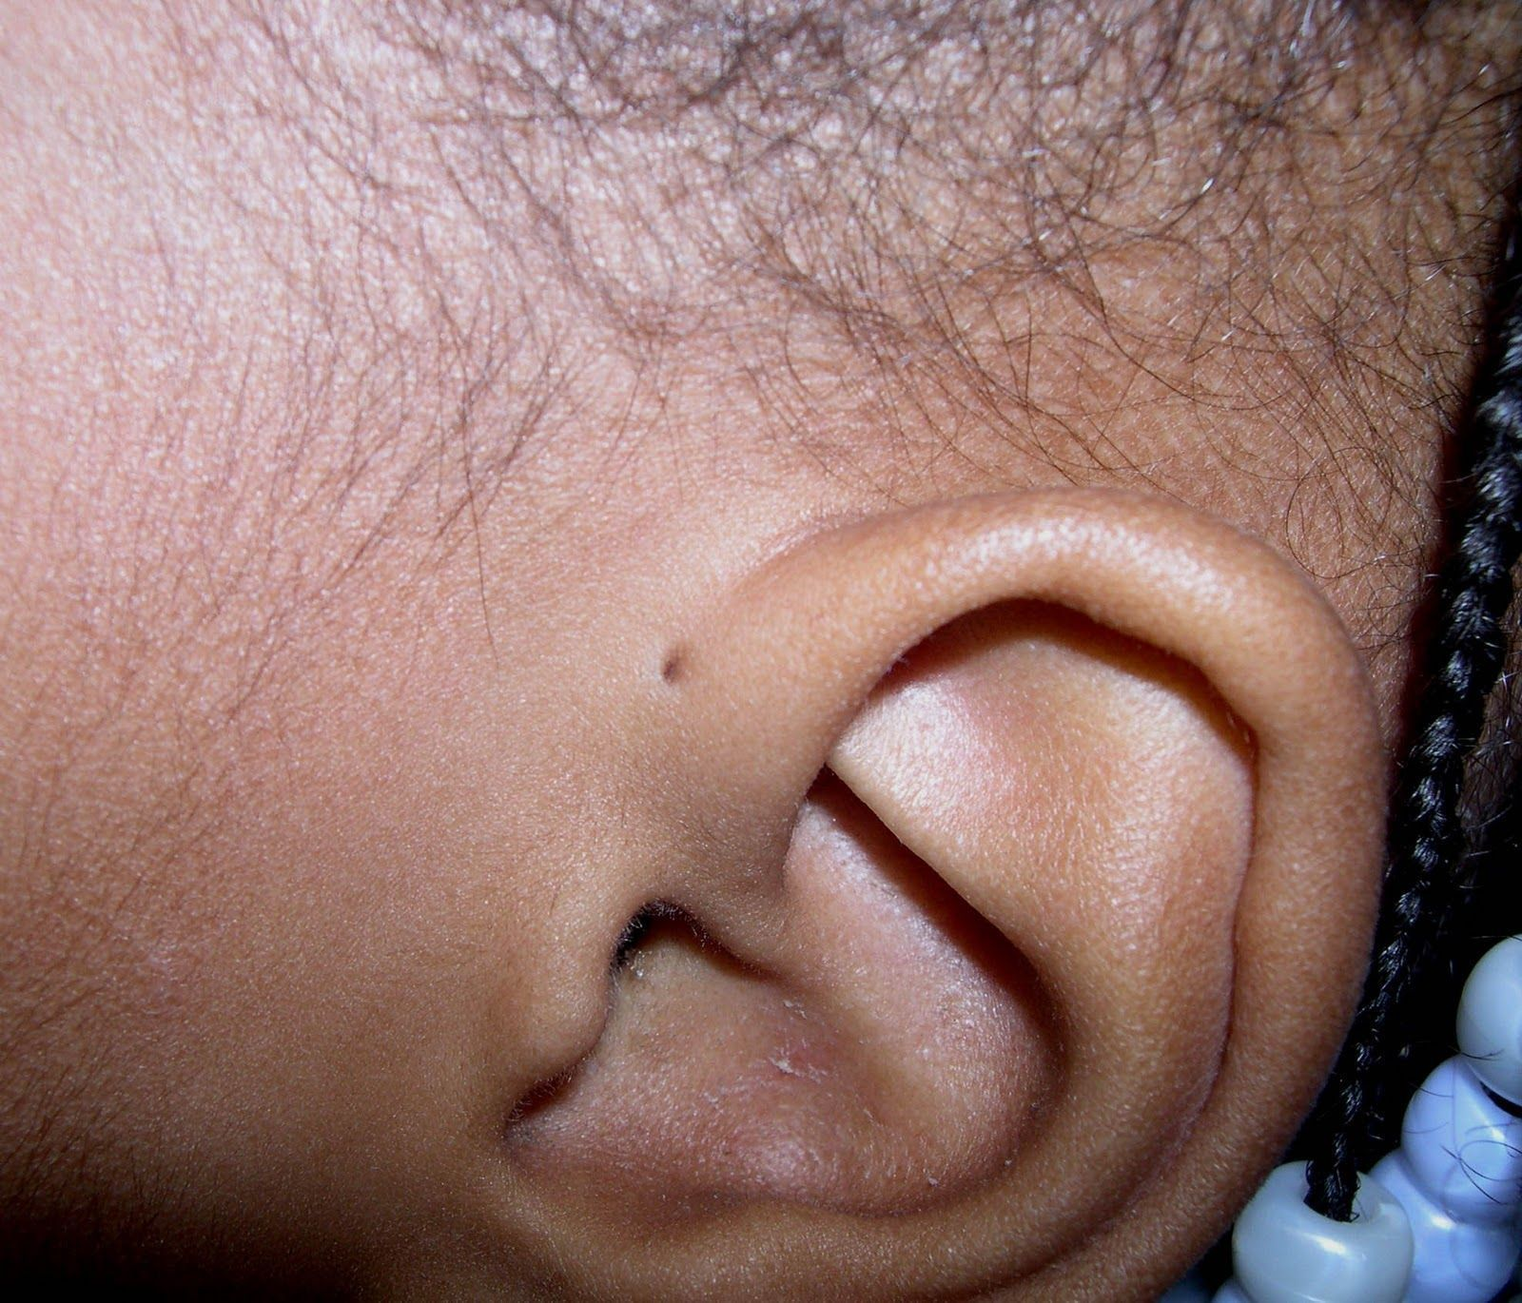
PREAURICULAR SKIN TAGS/ SINUS

Slide 12
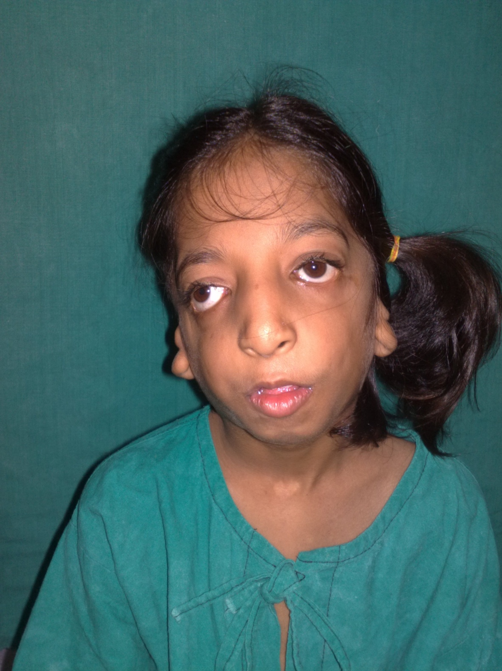
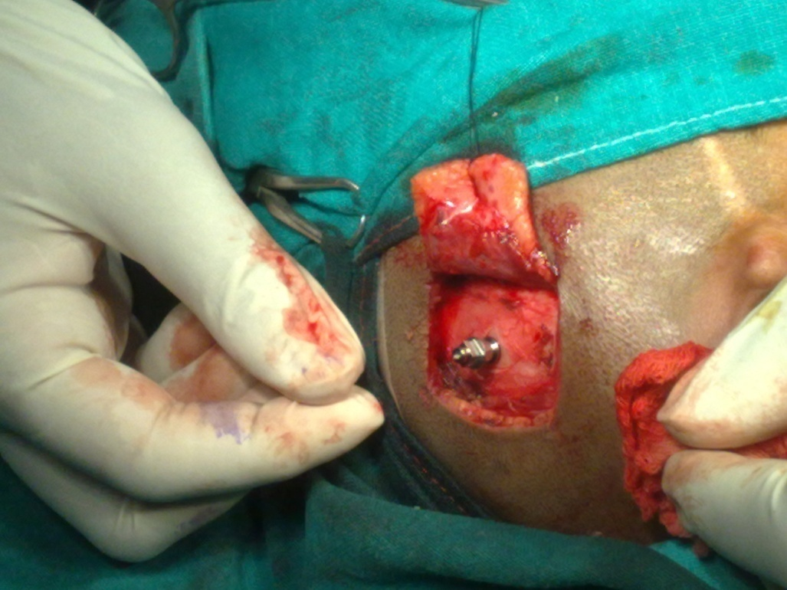

Slide 13
EXTERNAL AUDITORY CANAL

Slide 14
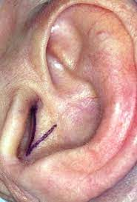
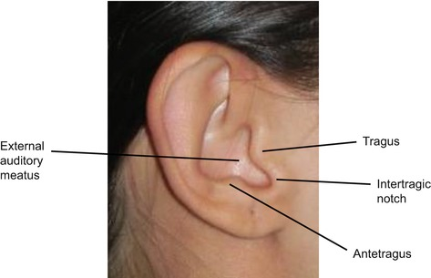

Slide 15
MIDDLE EAR

Slide 16
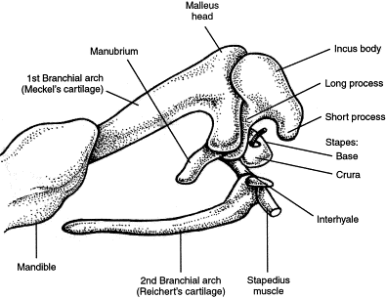

Slide 17
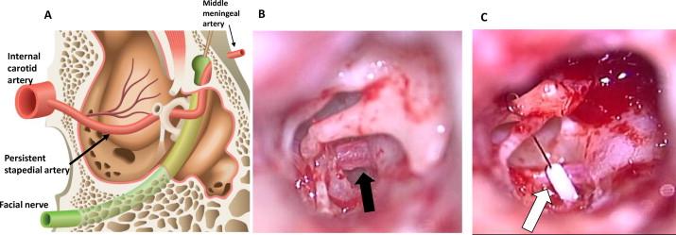

Slide 18
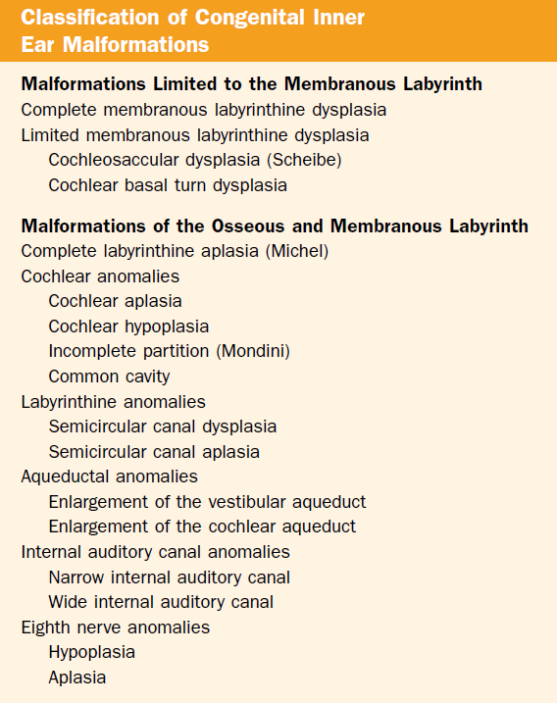
INNER EAR

Slide 20
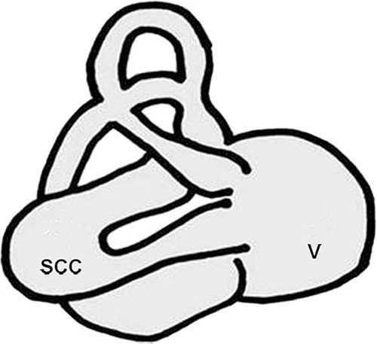

Slide 21
Syndromic associations
Wardenburg syndrome
Usher syndrome
Hemifacial anomalies:
Goldenhar syndrome
Treacher collins syndrome
Crouzon syndrome
Down’s syndrome
Pierre robin sequence
Pendred syndrome

